Slide 1
CIS 5200:Systems Analysis and Design Building & Safety Permit Submitted to Dr. Jongwook Woo
Submitted by: Bhagyashree Jadhav
Mittal Vaghela
Narendra Mali
California State University, Los Angeles

Slide 2
Table of Content
About Project
What have we used
Hive Queries
Graphs and Final Results
Conclusion

Slide 3
About project
Data analysis is done on Building and Safety Permit Information for the City of Los Angeles.
Data analysis is done using IBM Bluemix, HiveQL.
Analyzed data is visualized using Tableau, Google Fusion Table, PowerView, 3D Map In Excel in the form of Charts, Graphs and Maps.
Data Size
206 MB

Slide 4
Types of Permits
Permits are categorized into
Building Permits
Electrical Permits
Mechanical Permits
These permits are categorized into sub permit types such as
Fire Sprinkler
Swimming-Pool/Spa
Commercial

Slide 5
Big Data Life-Cycle
Capture Data
Visualize Data
Process Data
Analyze Data
Store Data

Slide 6
Flow Chart
Raw Data
In .CSV
Upload Data in Dropbox
PUT Data in HDFS
Visualization of Data
Loading Analyzed Data to Excel from BigInsight
Create Hive Tables & Queries

Slide 7




What Have We Used
BigInsight
Tableau
PowerView in Excel
Google Fusion Table
3D Map in Excel

Slide 8
Data Analysis
Data Analysis is Done On..
Permit
Permit Sub-Type
Permit Category
Contractor's Business Name
Permit Status
Issue Date of the Permit.
License Expiration Date
Valuation
State
City
License Type

Slide 9
Hardware Specifications
Cluster Type – Hadoop IBM Big Insights
Number of Data Nodes -1 Node | vCPU = 4 (24GB RAM)
Number of Management Nodes - 1 | vCPU = 12 (48 GB RAM)
Version – IOP 4.2 (IBM Open Version Platform)
Operating System – CentOS 6.6 [Linux]
Data Disk- 1 TB SATA | Data Storage- 244 GB
CPU Speed 2.25 GHz

Slide 10
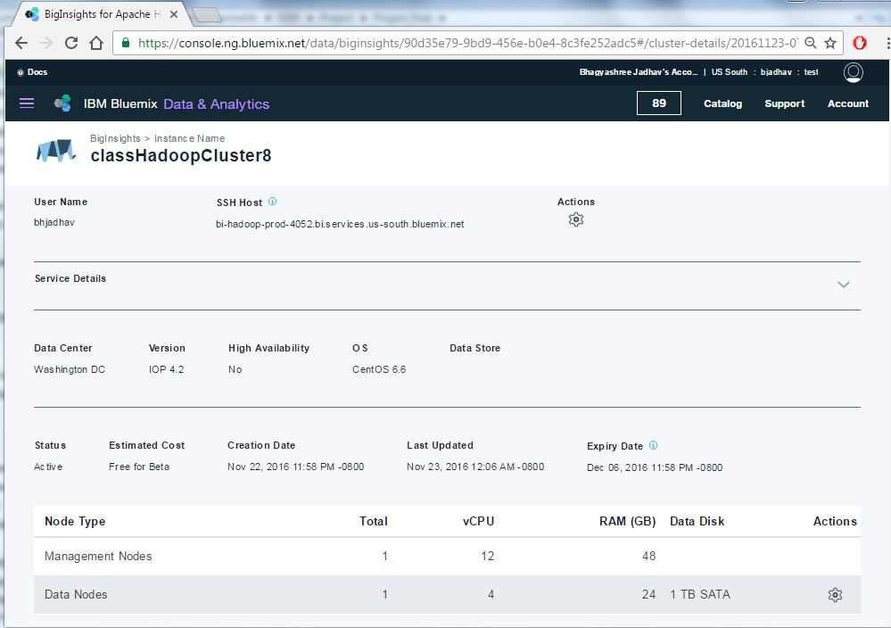
Details

Slide 11
Finding 1- Creating Table to Map Data
hive> CREATE EXTERNAL TABLE building_permit (
`Unique_ID` string, `Assessor Book` string, `Assessor Page` string, `Assessor Parcel` string, `Tract` string, `Lot` string, `PCIS Permit #` string, `Permit` string, `Permit Type` string, `Status` string, `Permit Sub-Type` string, `Status Date` string, `Permit Category` string, `Initiating Office` string, `Issue Date` string, `Address Start` string, `Address End` string, `Street Direction` string, `Street Name` string, `Street Suffix` string, `city` string, `Zip Code` string, `Work Description` string, `Valuation` string, `Contractor's Business Name` string, `Contractor Address` string, `Contractor City` string, `Contractor State` string, `License Type` string, `License #` string, `License Expiration Date` string, `Census Tract` string, `Latitude` string, `Longitude` string, `State` string, `Country` string)
ROW FORMAT DELIMITED FIELDS TERMINATED BY ',' STORED AS TEXTFILE LOCATION '/user/mvaghela/Building/' TBLPROPERTIES ('skip.header.line.count'='1');

Slide 12
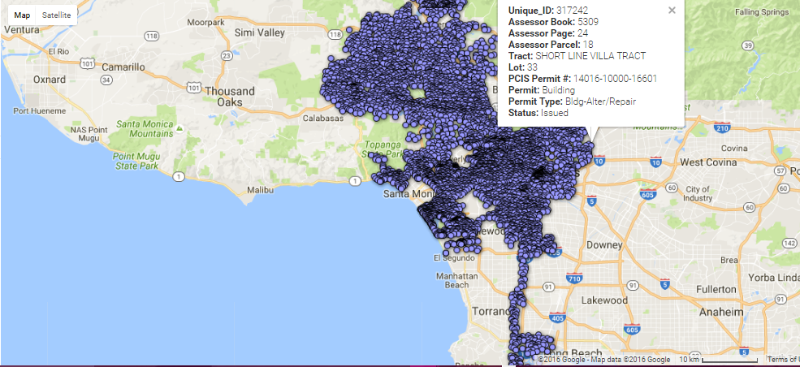
Displaying all the Permits using Google Fusion Table

Slide 13
Finding 2 – Permit Sub-type
Count of Permits by Permit Sub-Type for new contractors
hive > CREATE TABLE permit_count AS
> SELECT `Permit` , `Permit Sub-Type`, COUNT(`unique_ID`) AS ID
> FROM building_permit
> GROUP BY `Permit Sub-Type`, `Permit`;

Slide 14
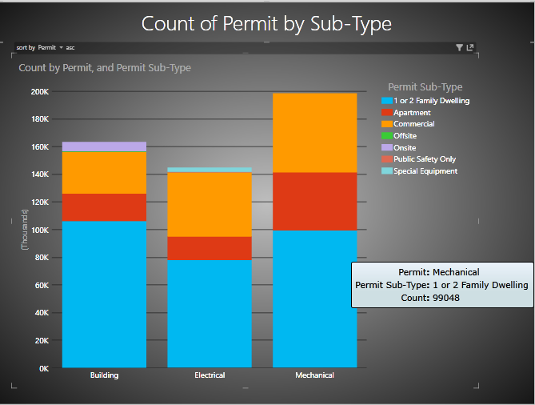
Output of Finding 2 using Excel Power View

Slide 15
Finding 3 – Permit Category
Permits by Plan Check or No Plan Check to get probability of getting express permit
hive> CREATE TABLE permit_category AS
> SELECT COUNT(`Permit category`), `Permit` , `Permit category`
> FROM building_permit
> GROUP BY `Permit`, `Permit category`;

Slide 16
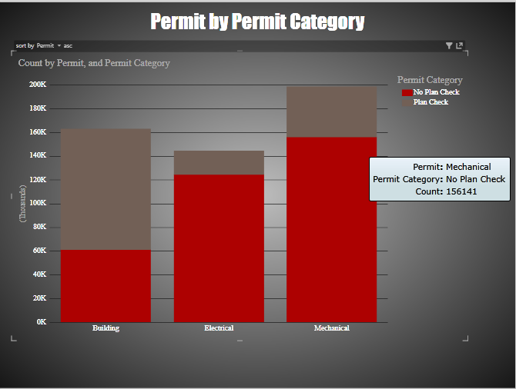
Output of Finding 3 Using Excel Power View

Slide 17
Finding 4 – Display Permits
Number of permits by City and Permit Subtype to know about permits in nearby cities
hive> CREATE TABLE map_permit AS
> SELECT `Permit` , `Permit Type`, `City`, `State`
> FROM building_permit;

Slide 18
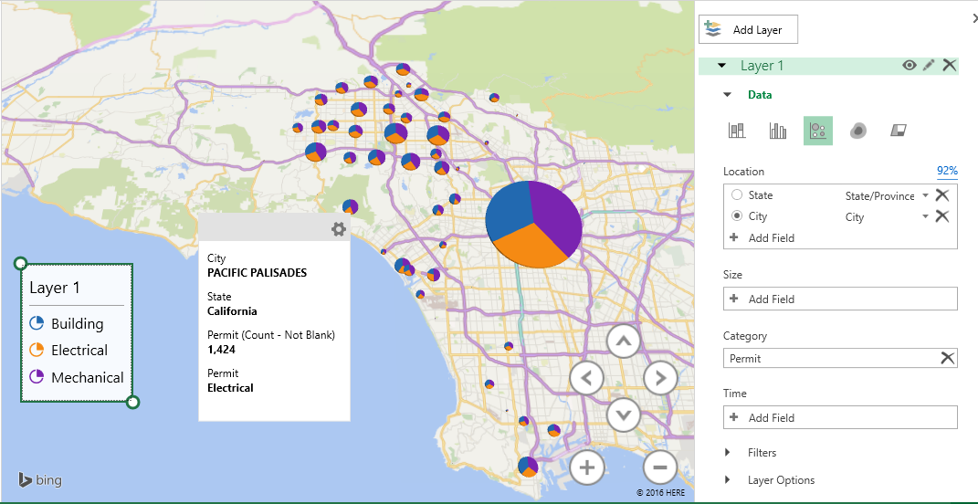
Output-1 of Finding 4 using Excel 3D Map

Slide 19
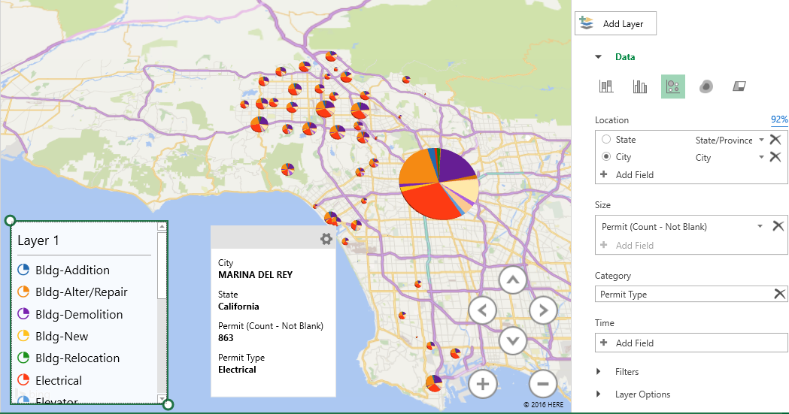
Output-2 of Finding 4

Slide 20
Finding 5 – Valuation of Permits
Average valuation of different types of Permits to provide new quotations based on it
hive> CREATE TABLE valuation AS
> SELECT `Permit`, AVG(`Valuation`) as average
> FROM building_permit
> GROUP BY `Permit`;

Slide 21
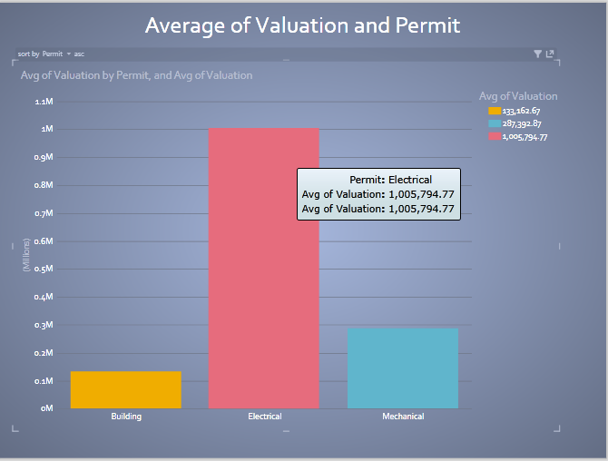
Output of Finding 5 using Excel Power View

Slide 22
Finding 6 – Contractor's Business Name
Contractor's Business Name by number of permits and their location to know competitors
hive> CREATE TABLE contractor AS
> SELECT `Contractor’s Business Name`, COUNT(`unique_ID`) AS ID, `Permit`, `Contractor City`, `Contractor State`
> FROM building_permit
> GROUP BY `Contractor’s Business Name`, `Permit`, `Contractor City`, `Contractor State`;

Slide 23
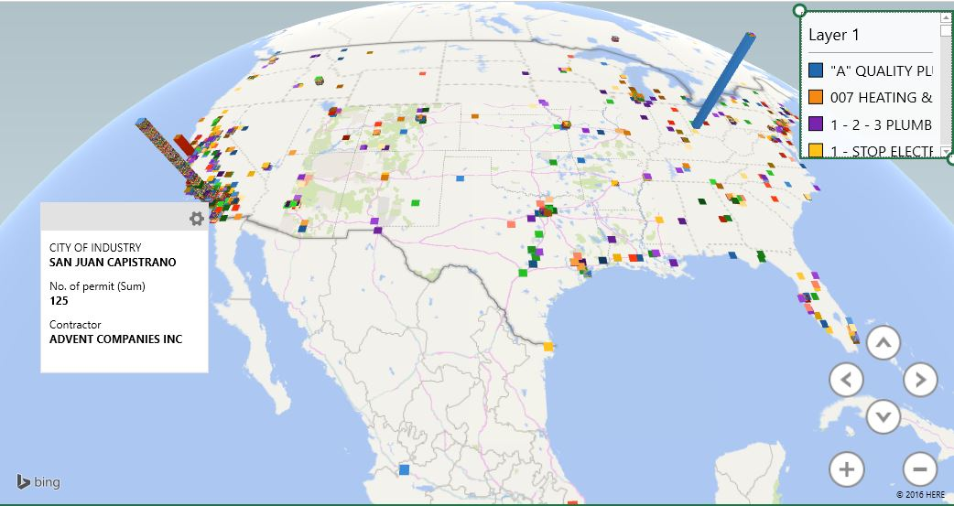
Output of Finding 6 using 3D Map

Slide 24
Finding 7 – Status
Count of permits by their status
hive> CREATE TABLE permit_status AS
> SELECT COUNT(`unique_ID`) , `Permit`, `Status`
> FROM building_permit
> GROUP BY `Status`, `Permit`;

Slide 25
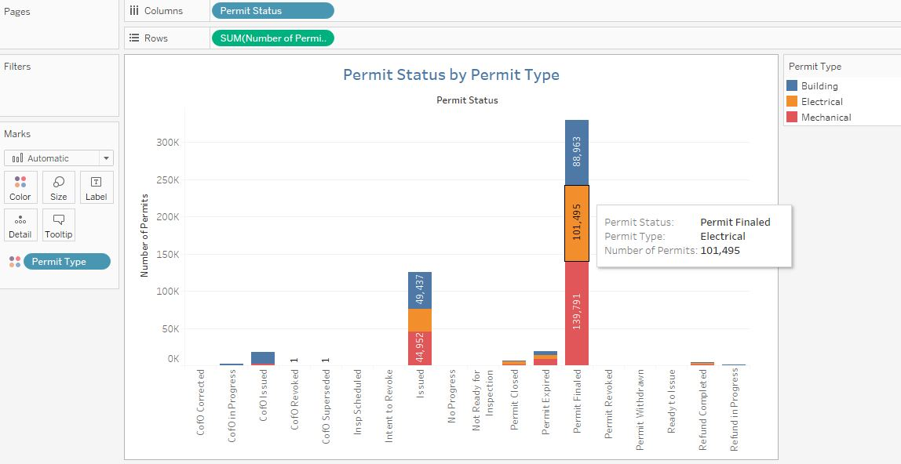
Output of Finding 7 using Tableau

Slide 26
Finding 8 – Permit Issue Date
Number of permits issued in particular year
hive> CREATE TABLE permit_year AS
> SELECT `Permit`, COUNT(`Issue Date`)
> FROM building_permit
> WHERE `Issue Date` rlike ‘.*(2013).*’
> GROUP BY `Permit`;

Slide 27
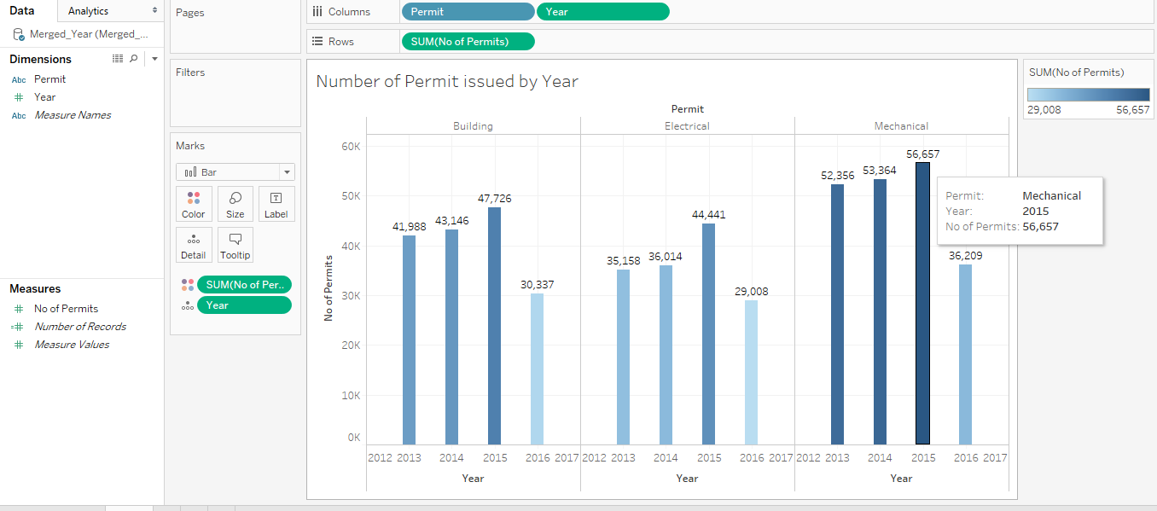
Output of Finding 8 using Tableau

Slide 28
License Types
B: General building.
C-10: Electrical
C-16: Fire Protection
C-20: Warm-Air heating, ventilating and Air-Conditioning
C-39: Roofing
C-46: Solar Contractor
C-53: Swimming Pool

Slide 29
Finding 9 – License Type
Count of License Type by it’s average valuation to know how much it costs approximately
hive> CREATE TABLE license AS
> SELECT `License Type`, COUNT(`Unique_ID`), AVG(`Valuation`)
> FROM building_permit
> GROUP BY `License Type`;

Slide 30
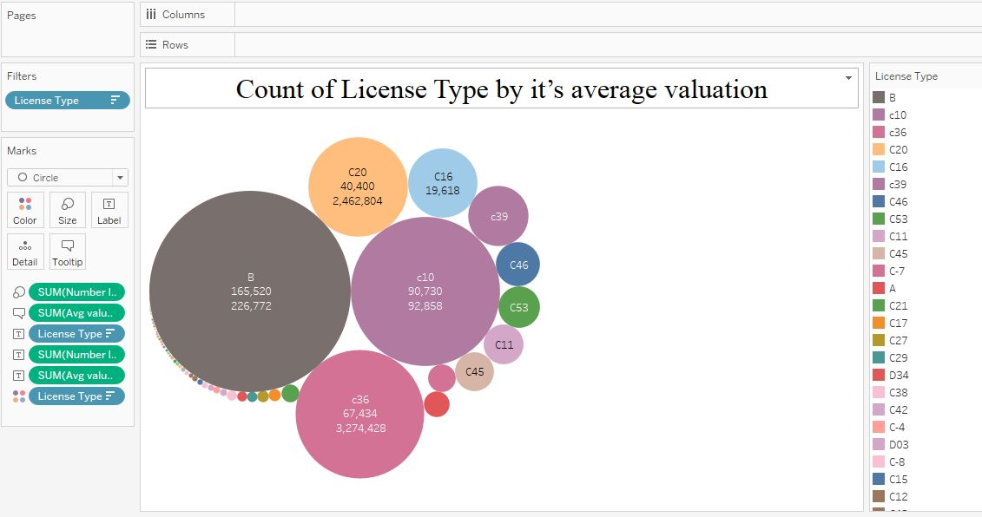
Output of Finding 9 using Tableau

Slide 31
Finding 10 – License Expiration Date
Number of license types by it’s expiration date to know which licenses are expiring
hive> CREATE TABLE license_exp AS
> SELECT `License Type`, COUNT(`Unique_ID`)
> FROM building_permit
> WHERE `License Expiration Date` rlike ‘.*(2017).*’ OR `License Expiration Date` rlike ‘.*(2018).*’
> GROUP BY `License Type`;

Slide 32
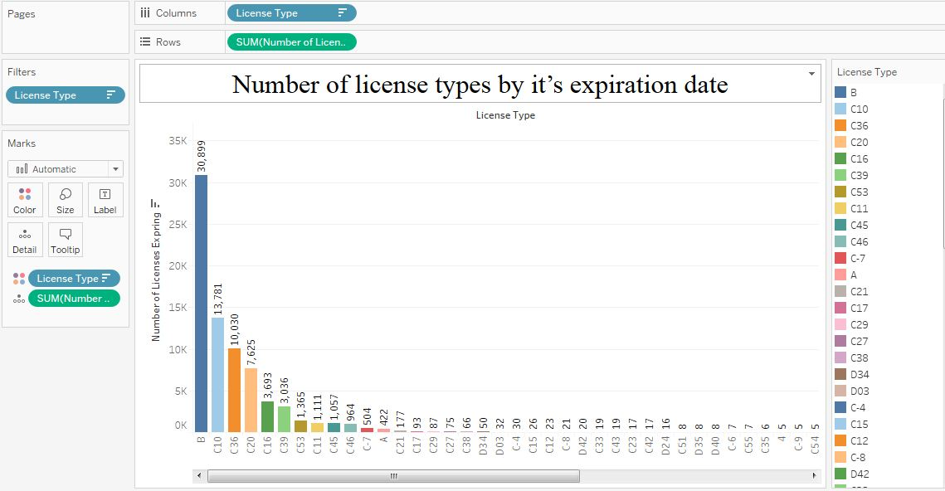
Output of Finding 10 using Tableau

Slide 33
Conclusion
Every year highest number of Permits have been issued for Mechanical Permit type since year 2013.
97% of the Contractors are California residents.
Most of the demolition work is being done in LA Downtown Area hence future construction possibility increases in that area.
Percentage increase is highest in Electrical Permit category when compared to previous year.
Maximum number of ‘General Building’ type of licenses are going to expire in next two years.

Slide 34
References
https://www.lacity.org/
http://www.tutorialspoint.com/hive/hive_data_types.htm
https://docs.treasuredata.com/articles/hive
http://www.cslb.ca.gov/Resources/GuidesAndPublications/DescriptionOfClassifications.pdf
http://www.tableau.com/learn/training

Slide 35
LINKS
GITHUB Link: (Code Only)
https://github.com/narendramali1/CIS5200
Presentation Slideshare Link:
http://www.slideshare.net/narendramali22/cis-5200presentation-groupb-69977271
Dataset Link: (Datasize – 206 MB)
https://data.lacity.org/A-Prosperous-City/Building-and-Safety-Permit-Information/yv23-pmwf

Slide 36
Thank You
Q & A

